Slide 1
PERFORMING THE COMMON CITY ThE VALUE OF CULTURE
Artistic Constitutions of the Public Sphere

Slide 2
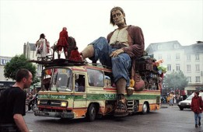
Culture
‘Way of life’
Giving meaning to human existence in society
Socialization (enculturation)
Qualification
Subjectification
Cultural Actors
Reflective design of ‘living together’
Measure and dismeasure of culture (dialectical)

Slide 3
City & Disorder
Adolescence
Communities
Identity as ‘sameness’
Haussmann
Disorder – Agony?

Slide 5
Art, Politics and Urban Order
Strategy
Monumental City
Creative Repressive City
Place Space
Situationist City
Common City
Tactic

Slide 6
REPRESSIVE LIBERALISM
‘While governments cut back everywhere and relegate tasks to the market, the supervisors who must guard the freedom of that market grow.’ (Achterhuis, 2010: 150)
‘There has never been a time in our history when more of our ‘culture’ was as ‘owned’ as it is now. And yet there has never been a time when the concentration of power to control the uses of culture has been as unquestioningly accepted as it is now.’ (Lessig, 2004: 12)
‘Under the rule of a repressive whole, liberty can be made into a powerful instrument of domination.’ (Marcuse, 1964: 7)

Slide 8
crisis
Social & Economical Inequality

Slide 9
GDP = GHP

Slide 10
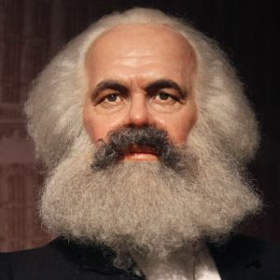
MISSING LINK?
CULTURE
Art

Slide 11
The Common City
Economy = Substructure:
Communism & Neoliberalism
Commonism: Culture = Substructure
Dissent - agonistic
Commons defines the
dynamics of culture
Identity = Becoming
Art feeds dissent through processes of subjectification
Performing the Common =
Making Identities again and again and again

